Slide 1
CHAPTER : ONE
Introduction to Artificial Intelligence (AI)

Slide 2
Contents
Introduction
AI Vs. KNB
Views of defining AI
Strong AI Vs. Weak AI
History of AI
State of the Art
Application of AI

Slide 3
Introduction
What is intelligence ?
Artificial Intelligence is composed of two words Artificial and Intelligence.
Artificial defines "man-made," and intelligence defines "thinking power", or “the ability to learn and solve problems” hence Artificial Intelligence means "a man-made thinking power."
  “The capacity to learn and solve problems” (Webster dictionary)
  The ability to think and act rationally
  Intelligence is the ability of observing, learning, remembering and reasoning something.
This course focuses on computational intelligence:
  Trying to understand the computational principles behind intelligent behavior
Top languages for AI
  Python
  Prolog
  R
  Lisp
  Java

Slide 4
Cont….
AI is the effort to develop computer based system(intelligent entities) that behave as human.
It enable computers behave/act like human and emulate the reasoning power of humans
  in order to do tasks that require human intelligence.
Which task requires intelligence?
  Complex arithmetic operations
    For instance, Solving 2²⁰ * 3⁵⁰?
  Every day/Mundane tasks
    Example, Natural language understanding; face recognition
  Expert tasks: which require specialists knowledge
    Example, Medical diagnosis; computer maintenance
Notes:
4

Slide 5
AI Foundations/Academic Disciplines important to AI.
AI is a synergy/cooperation of d/t disciplines
  A. Psychology/Cognitive Science: how do people behave, perceive, process information, represent knowledge.
  How do humans and animals think and act?
  Behaviorism, measuring of the percepts (or stimulus) given to an animal and its resulting actions (or response).
  Cognitive psychology, which views the brain as an information-processing device.
    For example, Craik clearly specified the three key steps of designing good knowledge-based agent:-
      (1) The stimulus must be translated into an internal representation,
      (2) The representation is manipulated by cognitive processes to derive new internal representations, and
      (3) These are in turn retranslated back into action.

Slide 6
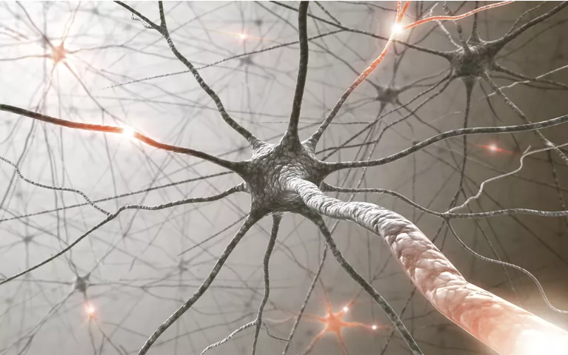
B. Neuroscience: Neurons as information processing units
  How do brains process information?
  Neuroscience is the study of the nervous system, particularly the brain.

Slide 7
Cont.
  C. Philosophy: Logic, methods of reasoning, foundations of learning & rationality.
  Can formal rules be used to draw valid conclusions?
  How does the mind arise from a physical brain?
  Where does knowledge come from?
  How does knowledge lead to action?
  D. Mathematics: Formal representation and proof, algorithms, computation, probability.
  What are the formal rules to draw valid conclusions?
  What can be computed?
  How do we reason with uncertain information?
  E. Linguistics: knowledge representation, grammar
  How does language relate to thought?
  Natural Language Processing is a hybrid field of modern linguistic and AI.

Slide 8
  F. Computer engineering: building fast computers.
  How can we build an efficient computer?
  For artificial intelligence to succeed, we need two things: intelligence and an artifact.
    The computer has been the artifact of choice.
  The modern digital electronic computer passed various historical innovations, like:-
    Operational Computer
    Programmable Computer
    Electronic Computer
  AI also owes a debt to the software side of computer science, which has supplied the operating systems, programming languages, and tools needed to write modern programs.

Slide 9
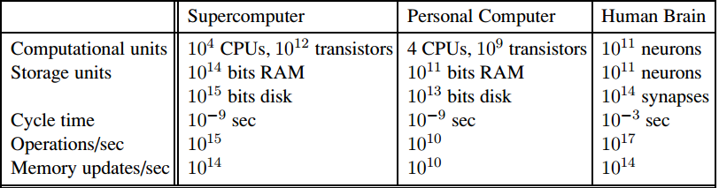
Computers vs. Human Brain
Figure is a crude comparison of the raw computational resources available to the IBM BLUE GENE supercomputer, a typical personal computer of 2008, and the human brain.
The brain’s numbers are essentially fixed, whereas the supercomputer’s numbers have been increasing by a factor of 10 every 5 years or so, allowing it to achieve rough parity with the brain.
The personal computer lags behind on all metrics except cycle time.

Slide 10
Brains and digital computers have somewhat different properties.
Previous figure shows that computers have a cycle time that is a million times faster than a brain.
The brain makes up for that with far more storage and interconnection than even a high-end personal computer, although the largest supercomputers have a capacity that is similar to the brain’s.
(It should be noted, however, that the brain does not seem to use all of its neurons simultaneously.)
Futurists make much of these numbers, pointing to an approaching singularity at which computers reach a superhuman level of performance (Vinge, 1993; Kurzweil, 2005), but the raw comparisons are not especially informative.
Even with a computer of virtually unlimited capacity, we still would not know how to achieve the brain’s level of intelligence.

Slide 11
Different people approach Al with different goals in mind,
Two important questions to ask are:
Are we concerned with thinking or behavior?
Do we want to model humans or work from an ideal standard?
We adopt the view that intelligence is concerned mainly with rational action.
Ideally, an intelligent agent takes the best possible action in a situation.
We study the problem of building agents that are intelligent in this sense
we rely on these three basic and interrelated human capacities:
  Affect (feelings)
  Behavior (interactions)
  Cognition (thought)

Slide 12
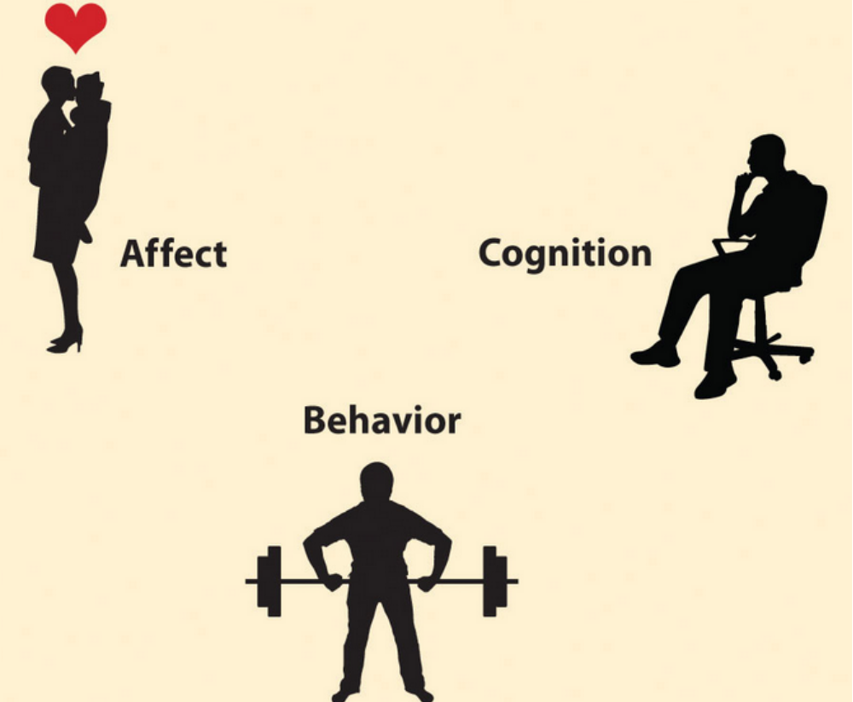

Slide 13
Characteristics of Intelligent system:
Use vast amount of knowledge
Learn from experience and adopt to changing environment
Interact with human using natural language and speech
Respond in real time
Tolerate error and ambiguity in communication

Slide 14
Artificial Intelligence vs. KBS
Knowledge based system is part of Artificial Intelligence
AI also requires extensive knowledge of the subject at hand.
  AI program should have knowledge base
  Knowledge representation is one of the most important and most active areas in AI.
  AI programs should be learning in nature and update its knowledge accordingly.

Slide 15
What is Knowledge
Knowledge includes facts about the real world entities and the relationship between them
  It is an understanding gained through experience
  Familiarity with the way to perform a task
  An accumulation of facts, procedural rules, or heuristics
Characteristics of Knowledge:
  It is voluminous/big in nature and requires proper structuring.
  It may be incomplete/partial and imprecise/indefinite.
  It may keep on changing (dynamic).

Slide 16
Knowledge base
Knowledge base is used to store facts and rules.
In order to solve problems, the computer needs an internal model of the world.
  This model contains, for example, the description of relevant objects and the relations between these objects.
  All information must be stored in such a way that it is readily accessible.
Various methods have been used for KR, such as logic, semantic networks, frames, scripts, etc...
Notes:
16

Slide 17
Knowledge base systems (KBSs)
is a computer program that reasons and uses a knowledge base to solve complex problem
KBS - is a form of artificial intelligence (AI) which captures the knowledge of human experts to support decision-making
Use inference to solve problems on a computer.
  Inference- is a conclusion reached on the basis of evidence and reasoning.
  Ability to make the workings of the human mind understandable and executable on a computer.

Slide 18
Views of AI/Some possible definitions of AI are:-
  Four AI Definitions by Russell + Norvig
AI is found on the premise that:
  workings of human mind can be explained in terms of computation, and
  computers can do the right thing given correct premises/properties and reasoning rules to achieve a specified goal.
Views of AI fall into four categories:
Thinking humanly | Thinking rationally
Acting humanly | Acting rationally

Slide 19
Views of defining AI
What is AI ?
  Different scholars define AI differently
(A) AI as a system that think humanly
(B) AI as a system that think rationally
Concerned with thought processing and reasoning
Concerned with behaviors of agents
(C) AI as a system that Act humanly
(D) AI as a system that Act rationally

Slide 20
Views of defining AI
measures success of AI in terms of human being performance
(A) AI as a system that think humanly
(C) AI as a system that Act humanly
measures success of AI in terms of ideal concept of intelligence (rationality)
(B) AI as a system that think rationally
(D) AI as a system that Act rationally

Slide 21
I. Thinking humanly: The Cognitive Modeling
Cognitive Science
  The brain as an information processing machine.
  Requires scientific theories of how the brain works
How to understand cognition as a computational process?
  Introspection, try to think about how we think
  Predict and test behavior of human subjects
  Image the brain, examine neurological data
Reasons like humans do
  Programs that behave like humans
  Is concerned with modeling human thinking processes
Requires understanding of the internal activities of the brain
  see how humans behave in certain situations and see if you could make computers behave in that same way.
  Protocol analysis (think aloud) can help in understanding how human beings solve a given problem
Example. write a program that plays chess.
  Instead of making the best possible chess-playing program, you would make one that play chess like people do.

Slide 22
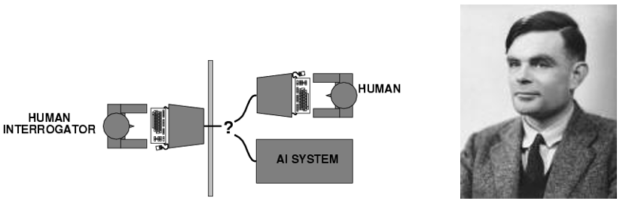
II. Acting humanly: The Turing Test
Can machines act like human do? Can machines behave intelligently?
  Acting like humans requires AI programs to interact with people
Turing Test:
What capabilities would a computer need to have to pass the Turing Test?
  Natural Language Processing
  Knowledge Representation
  Automated Reasoning
  Machine Learning

Slide 23
Turing Test Criticisms
  There are some potential problems with the Turing Test, for example:-
    Some human behavior is not intelligent
    Some intelligent behavior may not be human
    Human observers may be easy to fool.
    The “Chinese Room Argument”, that is one may simulate intelligence without having true intelligence
  Is passing the Turing test a good scientific goal?

Slide 24
III. Thinking Rationally: The Laws of Thought
Idealized or “right” way of thinking.
Logic
  Patterns of argument that always yield correct conclusions when supplied with correct premises
  “Socrates is a man;
  All men are mortal;
  Therefore Socrates is mortal.”
Beginning with Aristotle, philosophers and mathematicians have attempted to formalize the rules of logical thought.

Slide 25
Logical Approach to AI
  Describe problem in formal logical notation and apply general deduction procedures to solve it.
  Problems with the logical approach are:-
    Computational complexity of finding the solution.
    Describing real-world problems and knowledge in logical notation.
    A lot of intelligent or “rational” behavior has nothing to do with logic.

Slide 26
IV. Acting rationally: The rational agent
A rational agent is one that acts to achieve the best outcome.
  Goals are application-dependent and are expressed in terms of the utility of outcomes.
  Being rational means maximizing your expected utility.
This definition of rationality only concerns the decisions/actions that are made, not the cognitive process behind them.
Central to our approach to AI
Doing the right thing so as to achieve one’s goal, given one’s beliefs.
  AI is the study and construction of rational agents (an agent that perceives and acts)
Rational action requires the ability to represent knowledge and reason with it so as to reach good decision.
  Learning for better understanding of how the world works

Slide 27
The State of The Art
Robotic Vehicles
Speech Recognition
Autonomous Planning and Scheduling
Game Playing
Spam Fighting
Fraud Detection
Robotics
Machine Translation
Vision
Drones
Medical diagnosis

Slide 28
What do we get from using AI technology instead of previous reactive technology?
Following are some main advantages of Artificial Intelligence:
A. High Accuracy with fewer errors as it made decisions as pre-experience or information.
B. High-Speed: AI systems can be of very high-speed and fast-decision making
C. High reliability: AI machines are highly reliable and can perform the same action multiple times with high accuracy.
D. Useful for risky areas: AI machines can be helpful in situations such as defusing a bomb, exploring the ocean floor, where to employ a human can be risky.
E. Digital Assistant: AI technology is currently used by various E-commerce websites to show the products as per customer requirements.
F. Useful as a public utility: Such as a self driving car ,facial/message recognition for security purposes, Natural language processing (for search engines, for spelling checker etc.

Slide 29
Some of the disadvantages of AI are:
A. High Cost: The hardware and software requirement of AI is very costly as it requires lots of resource to meet current world requirements.
B. Can't think out of the box: Even we are making smarter machines with AI, but still they cannot work out of the box, as the robot will only do that work for which they are trained, or programmed.
C. No feelings and emotions: AI machines can be an outstanding performer, but still it does not have the feeling so it cannot make any kind of emotional attachment with humans, and may sometime be harmful for users if the proper care is not taken.
D. Increase dependence on machines: With the increment of technology, people are getting more dependent on devices and hence they are losing their mental capabilities.
E. No Original Creativity: As humans are so creative and can imagine some new ideas but still AI machines cannot beat this power of human intelligence and cannot be creative and imaginative.

Slide 30
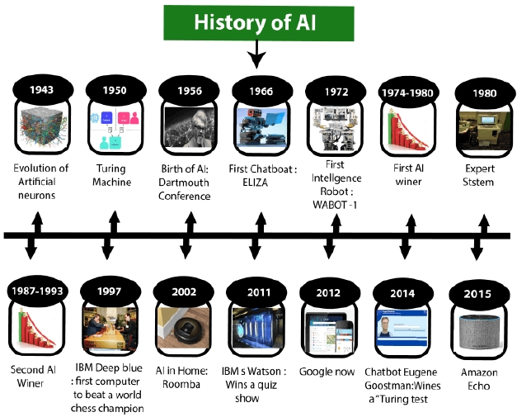
History of AI
Artificial Intelligence is not a new word and not a new technology for researchers.
This technology is much older than you would imagine.
Even there are the myths of Mechanical men in Ancient Greek and Egyptian Myths.
The following are some milestones in the history of AI which define the journey from the AI generation to till date development (see Figure 3.3).
Figure 3.3 History of Artificial Intelligence (AI)

Slide 31
A. Maturation of Artificial Intelligence (1943-1952)
The year 1943: Warren McCulloch and Walter pits are proposed a model of artificial neurons.
The year 1949: Donald Hebb modifying the connection strength between neurons. His rule is now called Hebbian learning.
The year 1950: Alan Turing proposed a test can check the machine's ability to exhibit intelligent behavior equivalent to human intelligence, called a Turing test.
B. The birth of Artificial Intelligence (1952-1956)
The year 1955: An Allen Newell and Herbert A. Simon created the "first artificial intelligence program" Which was named "Logic Theorist".
The year 1956: John McCarthy ,AI coined as an academic field. At that time high-level computer languages such as FORTRAN, LISP, or COBOL were invented.

Slide 32
C. The golden years-Early enthusiasm (1956-1974)
➢ The year 1966: Joseph Weizenbaum created the first chatbot in 1966, which was named as ELIZA.
➢ The year 1972: The first intelligent humanoid robot was built in Japan which was named WABOT-1.
D. The first AI winter (1974-1980)
➢ AI winter refers to the time period where computer scientists dealt with a severe shortage of funding from the government for AI researches.
➢ During AI winters, an interest in publicity/promotion on artificial intelligence was decreased.
E. A boom of AI (1980-1987)
➢ The year 1980: AI came back with "Expert System". Expert systems were programmed that emulate the decision-making ability of a human expert.
➢ In the Year 1980, the first national conference of the American Association of Artificial Intelligence was held at Stanford University.

Slide 33
F. The second AI winter (1987-1993)
➢ The duration between the years 1987 to 1993 was the second AI Winter duration.
➢ Again, Investors and government stopped in funding for AI research due to high cost but not efficient results.
The expert system such as XCON was very cost-effective.
( XCON /Expert configure ,automatically selecting the computer system components based on the customer's requirements
Examples are: MYCIN: It could identify various bacteria that could cause acute infections.
DENDRAL: Used for chemical analysis to predict molecular structure.
PXDES: Used to predict the degree and type of lung cancer.
G. The emergence/rise of intelligent agents (1993-2011)
➢ The year 1997: In the year 1997, IBM Deep Blue beats world chess champion, Gary Kasparov, and became the first computer to beat a world chess champion.
➢ The year 2002: for the first time, AI entered the home in the form of Roomba, a vacuum cleaner.
➢ The year 2006: AI came into the Business world until the year 2006. Companies like Facebook, Twitter, and Netflix also started using AI.

Slide 34
H. Deep learning, big data and artificial general intelligence (2011-present)
➢ The year 2011: In the year 2011, IBM's Watson won jeopardy, a quiz show, where it had to solve complex questions as well as challenges.
Watson had proved that it could understand natural language and can solve tricky questions quickly.
➢ The year 2012: Google has launched an Android app feature "Google now", which was able to provide information to the user as a prediction.
➢ The year 2014: In the year 2014, Chatbot "Eugene Goostman" won a competition in the infamous "Turing test."
➢ The year 2018: The "Project Debater" from IBM debated on complex topics with two master debaters and also performed extremely well.
Nowadays companies like Google, Facebook, IBM, and Amazon are working with AI and creating amazing devices.
The future of Artificial Intelligence is inspiring and will come with high intelligence.

Slide 35
How to make computers act like humans?
The following sub-fields are emerged
Natural Language processing (enable computers communicate in human language, English, Amharic, ..)
Knowledge representation (schemes to store information, both facts and inferences, before and during interrogation/interview/questioning)
Automated reasoning (use stored information to answer questions and to draw new conclusions)
Machine learning (adapt to new circumstances/conditions and accumulate/collect knowledge)
Computer vision (recognize/identify objects based on patterns/designs in the same way as the human visual system does)
Robotics (produce mechanical device capable of controlled motion; which enable computers to see, hear & take actions)
Is AI equals human intelligence? Can we create a KBS called mind?

Slide 36
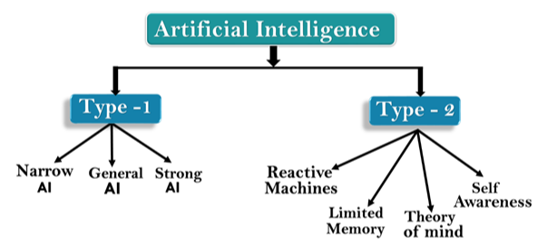
Types of AI
Artificial Intelligence can be divided into two categorization which are based on capabilities and based on functionally of AI.
Figure types of Artificial Intelligence (AI)
A. Based on Capabilities
Weak AI or Narrow AI: is a type of AI which is able to perform a dedicated task with intelligence.
Narrow AI , it is only trained for one specific task.
Some Examples of Narrow AI are Google translate, playing chess, self-driving cars, speech recognition, and image recognition.

Slide 37
2. General AI: is a type of intelligence that could perform any intellectual task with efficiency like a human.
The idea behind the general AI to make such a system that could be smarter and think like a human on its own.
Currently, there is no such system exists which could come under general AI and can perform any task as perfect as a human.
The worldwide researchers are now focused on developing machines with General AI.
As systems with general AI are still under research, and it will take lots of effort and time to develop such systems.

Slide 38
3. Super AI: is a level of Intelligence of Systems at which machines could surpass human intelligence, and can perform any task better than a human with cognitive properties.
Some key characteristics of strong AI include capability include the ability to think, to reason solve the puzzle, make judgments, plan, learn, and communicate on its own.
B. Based on the functionality
1. Reactive Machines
Purely reactive machines are the most basic types of Artificial Intelligence.
Such AI systems do not store memories or past experiences for future actions.
These machines only focus on current scenarios and react on it as per possible best action.
IBM's Deep Blue system is an example of reactive machines.
Google's AlphaGo is also an example of reactive machines

Slide 39
2. Limited Memory
Limited memory machines can store past experiences or some data for a short period of time.
These machines can use stored data for a limited time period only.
Self-driving cars are one of the best examples of Limited Memory systems.
These cars can store the recent speed of nearby cars, the distance of other cars, speed limits, and other information to navigate the road.
3. Theory of Mind
Theory of Mind AI should understand human emotions, people, beliefs, and be able to interact socially like humans.
This type of AI machines is still not developed, but researchers are making lots of efforts and improvement for developing such AI machines.

Slide 40
4. Self-Awareness
Self-awareness AI is the future of Artificial Intelligence.
These machines will be super intelligent and will have their own consciousness, sentiments, and self-awareness.
These machines will be smarter than the human mind.
Self-Awareness AI does not exist in reality still and it is a hypothetical concept.

Slide 41
Applications of AI
AI used to solve complex problems in efficient way in multiple industries, such as Healthcare, entertainment, finance, education, etc.
AI is making our daily life more comfortable and faster.
AI in agriculture:- Agriculture is an area that requires various resources, labor, money, and time for the best result.
Now a day's agriculture is becoming digital, and AI is emerging in this field.
  For example agriculture robotics, crop monitoring, and predictive analysis.
B. AI in Healthcare: In the last, five to ten years, AI becoming more advantageous for the healthcare industry and going to have a significant impact on this industry to make a better and faster diagnosis than humans.

Slide 42
C. AI in education:
AI can automate grading so that the tutor can have more time to teach.
AI chatbot can communicate with students as a teaching assistant.
AI in the future can be work as a personal virtual tutor for students, which will be accessible easily at any time and any place.
D. AI in Finance and E-commerce
AI and finance industries are the best matches for each other.
AI is providing a competitive edge to the e-commerce industry, and it is becoming more demanding in the e-commerce business. AI is helping shoppers to discover associated products with recommended size, color, or even brand.
E. AI in Gaming
AI can be used for gaming purposes.
The AI machines can play strategic games like chess, where the machine needs to think of a large number of possible places.

Slide 43
F. . AI in Data Security
AI can be used to make your data more safe and secure.
Some examples such as AEG bot, AI2 Platform, are used to determine software bugs and cyber-attacks in a better way.
G. AI in Social Media
Social Media sites such as Facebook, Twitter, and Snapchat contain billions of user profiles, which need to be stored and managed in a very efficient way.
H. AI in Travel &Transport
AI is capable of doing various travel related works such as from making travel arrangements to suggesting the hotels, flights, and best routes to the customers.
I. AI in the Automotive Industry
Various Industries are currently working for developing self-driven cars which can make your journey more safe and secure.
J. AI in Robotics:
Humanoid Robots are the best examples for AI in robotics, recently the intelligent Humanoid robot named Erica and Sophia has been developed which can talk and behave like humans.
K. AI in Entertainment
We are currently using some AI-based applications in our daily life with some entertainment services such as Netflix or Amazon.

Slide 44
Sample AI application with hands activity
A. Commuting
Google’s AI-Powered Predictions
Ridesharing Apps Like Uber and Lyft
Commercial Flights Use an AI Autopilot
B. Email
Spam Filters
Smart Email Categorization
C. Social Networking
  Facebook - When you upload photos to Facebook, the service automatically highlights faces and suggests friends tag.
  Pinterest - Pinterest uses computer vision, an application of AI where computers are taught to “see,” in order to automatically identify objects in images (or “pins”) and then recommend visually similar pins.
  Instagram -Uses machine learning to identify the contextual meaning of emoji, which have been steadily replacing slang (for instance, a laughing emoji could replace “lol”)
  Snapchat - Snapchat introduced facial filters, called Lenses, in 2015.
  These filters track facial movements, allowing users to add animated effects or digital masks that adjust when their faces moved.

Slide 45
D. Online Shopping
Search - Your Amazon searches (“ironing board”, “pizza stone”, “Android charger”, etc.) quickly return a list of the most relevant products related to your search
Recommendations - You see recommendations for products you’re interested in as “customers who viewed this item also viewed.
E. Mobile Use
Voice-to-Text - By pressing a button or saying a particular phrase (“Ok Google”, for example), you can start speaking and your phone converts the audio into text.
Smart Personal Assistants - Now that voice-to-text technology is accurate enough to rely on for basic conversation, it has become the control interface for a new generation of smart personal assistants.
Siri and Google Now (now succeeded by the more sophisticated Google Assistant),
Alexa, an AI-powered personal assistant that accepts voice commands to create to-do lists, order items online, set reminders, and answer questions (via internet searches)
Echo (and later, Dot) smart speakers that allow you to integrate Alexa into your living room and use voice commands to ask natural language questions, play music, order pizza, hail an Uber, and integrate with smart home devices.
Microsoft has followed suit with Cortana, its own AI assistant that comes pre- loaded on Windows computers and Microsoft smartphones.

Slide 46
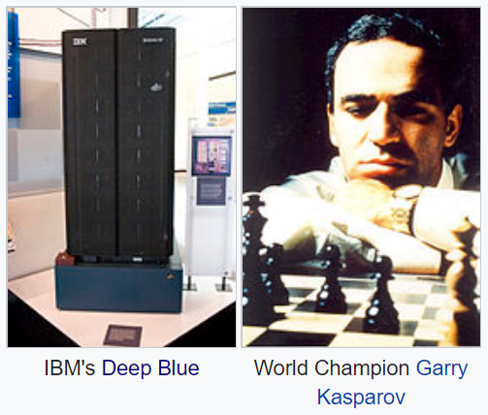
AI Successes
Deep Blue defeated the leading world chess champion Garry Kasparov in 1997.
Deep Blue was a chess-playing computer developed by IBM
First computer chess-playing system to win a chess match against a ruling world champion under regular time controls.

Slide 47
Cont.
Watson - The computer system was initially developed to answer questions on the quiz show Jeopardy.
In 2011, the Watson computer system competed on Jeopardy! against legendary champions Brad Rutter and Ken Jennings winning the first place prize of $1 million.

Slide 48
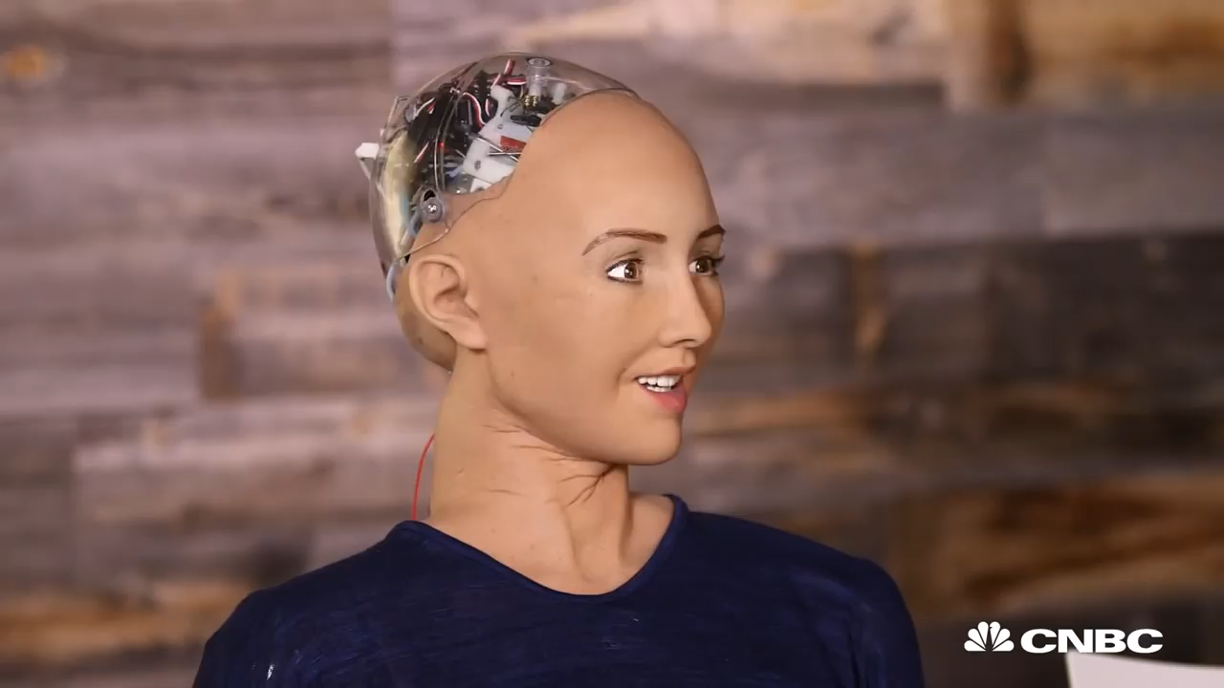

Slide 49

Google Self Driving Cars

Slide 50
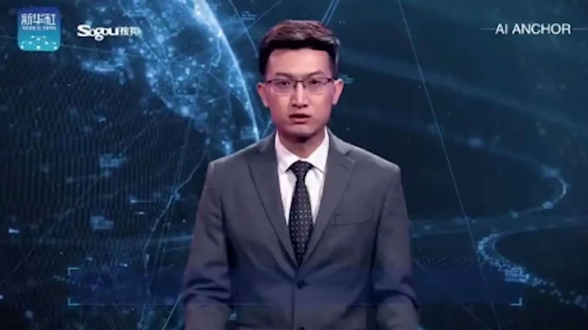

World's first AI presenter unveiled in China - (9-11-2018)
The World’s First AI News Anchor

Slide 51
Cont..
Games: chess, checkers, poker, etc.
Physical skills: driving a car, driving a motorcycle, flying a plane or
helicopter, playing soccer, vacuuming, etc.
Art: painting, composing music, performing music, etc.
Language: machine translation, speech recognition, character recognition, etc.
Vision: face recognition, face detection, motion tracking, etc.
Commerce and industry: page rank for searching, fraud detection, stock market investing, etc.

Slide 52
Challenges Ahead
Note that the examples we discussed so far all involve quite specific tasks.
The systems lack a level of generality and adaptability. They can't easily (if at all) switch context.
Key issue:
  knowledge acquisition/ achievment bottleneck
  Lack of general common sense knowledge.
  Big data

Slide 53
Some extra discussion points
Discuss one of the following concepts.
  Knowledge based system:
      What is KBS?
      KBS vs. ES vs. AI
      Knowledge acquisition, knowledge modeling and knowledge representation (semantic networks, frame, production system, ontology)
  Reasoning:
      What is reasoning, Case based reasoning, probabilistic reasoning, fuzzy reasoning, rule-based reasoning
  Learning:
      What is Machine learning? Support Vector Machine, Hidden Markov Model, Bayesian Belief Network
Explain the following areas of AI and how they work ?
  Natural Language Processing
  Natural Language Generation
  Speech Recognition, Speech synthesis, Speaker Identification
  Optical Character Recognition (OCR),Writer identification, Face recognition
  Computer vision and robotics

